Slide 1
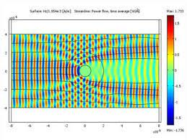
Cloaking Device
By: Maya Parsons and Mary Houck

Slide 2
Table of Contents
History
History (part 2):
Implementation
Positives
Negatives
Summary
Opinions
References

Slide 3

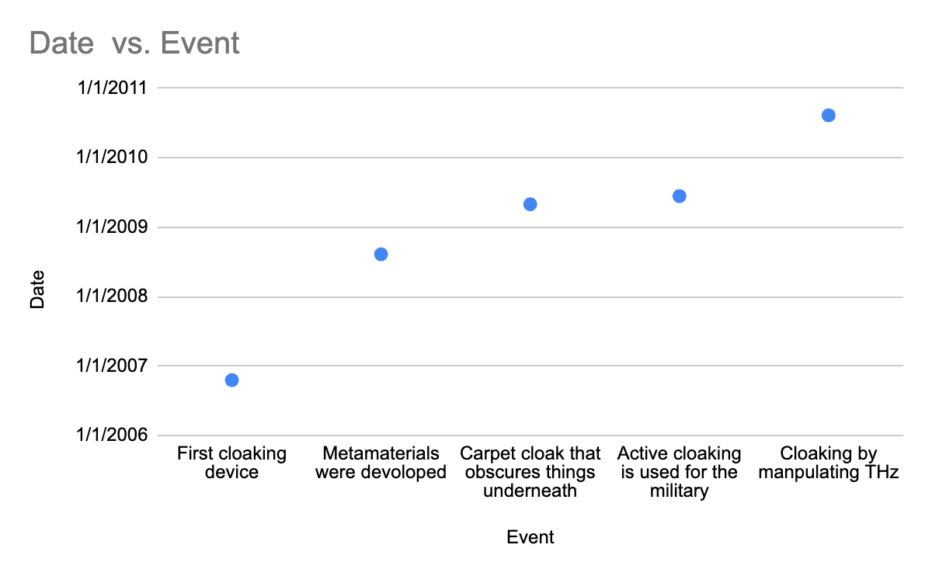
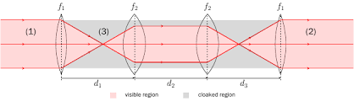
History
UC Berkeley scientists with their cloaking device technology:
The cloaking device first created in 1966 in a Star Trek episode.
However, invisibility as a concept was first imagined by Plato in 450-7 B.C.E.
In 2006, Duke University physicists made the first “real” cloaking device.
Since then, many improvement have been made to the cloaking device:
2008: UC Berkeley developed metamaterials to bend electromagnetic waves
Notes:
The idea of the cloaking device specifically was first created in 1966 in a Star Trek episode. However, invisibility as a concept was first imagined by Plato in 450-7 B.C.E. The Harry Potter series also popularized the idea of the cloaking device as well. Before 2006, the concept of the cloaking device was always seen as “make believe”, but this would soon change. In 2006, Duke University physicists made the first “real” cloaking device. It was created by metamaterials which used complex metal wires, and loops to control electromagnetic radiation. This creation was an amazing triumph, but only worked in two dimensions, and only on microwaves. Since then, many improvement have been made to the cloaking device: 2008: UC Berkeley developed metamaterials to bend electromagnetic waves2009: UC Berkeley created a “carpet cloak” which made objects underneath invisible from above (the outline of the cloak was still visible)

Slide 4
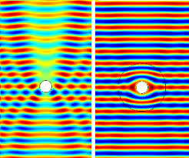
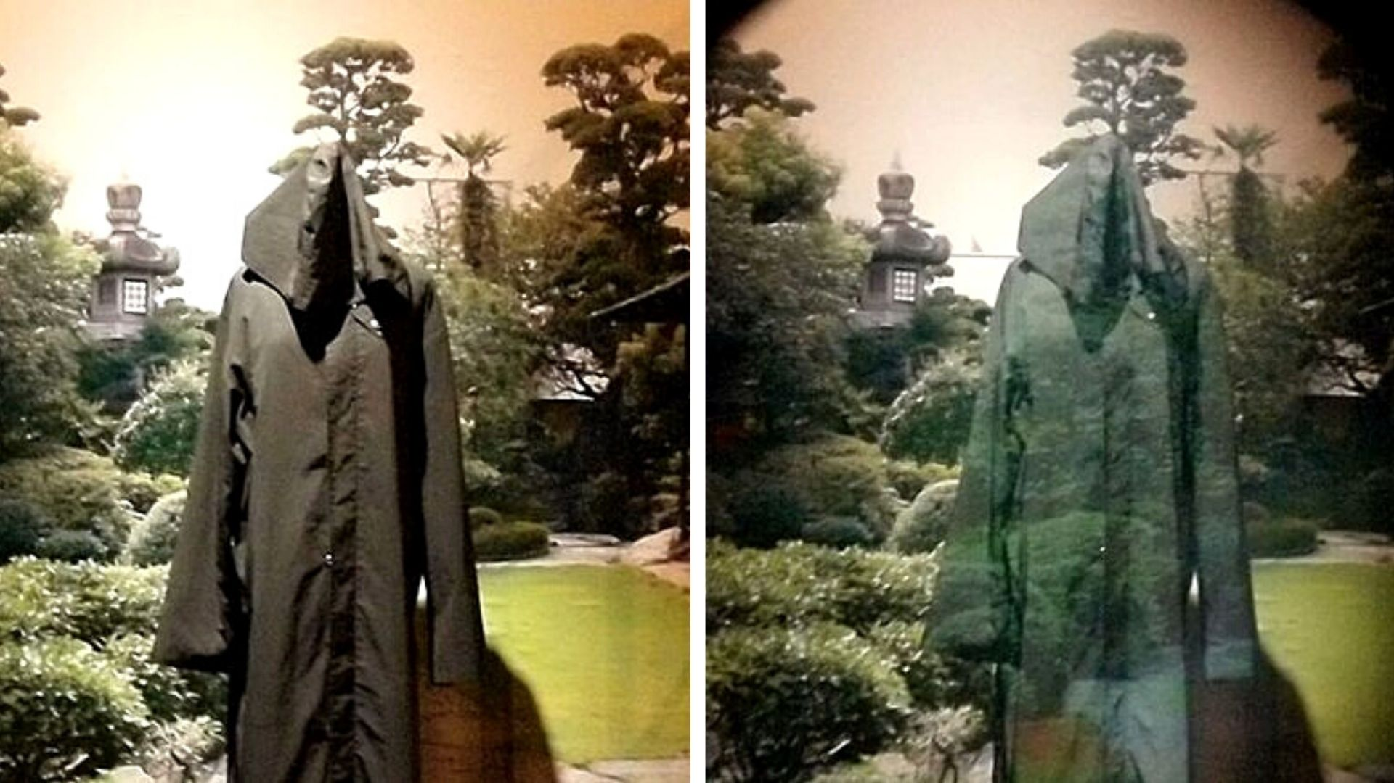
History (part 2):
2009: UC Berkeley created a “carpet cloak” which made objects under invisible (the cloak itself was still visible)
2009: The British military experiments with “active cloaking”.
2010: Scientists at Tufts University and Boston University created an invisibility cloak that manipulated terahertz waves.
Example of active cloaking:
Notes:
2009: UC Berkeley created a “carpet cloak” which made objects under invisible (the cloak itself was still visible) 2009: The British military experiments with “active cloaking”. Active cloaking is camouflaging military objects/equipment to the surrounding environment to match its changing background. In theory, this sounds like a good idea, but it only was effective from one view, and the military equipment wasn’t 100% invisible. 2010: Scientists at Tufts University and Boston University created an invisibility cloak that manipulated terahertz waves.

Slide 5
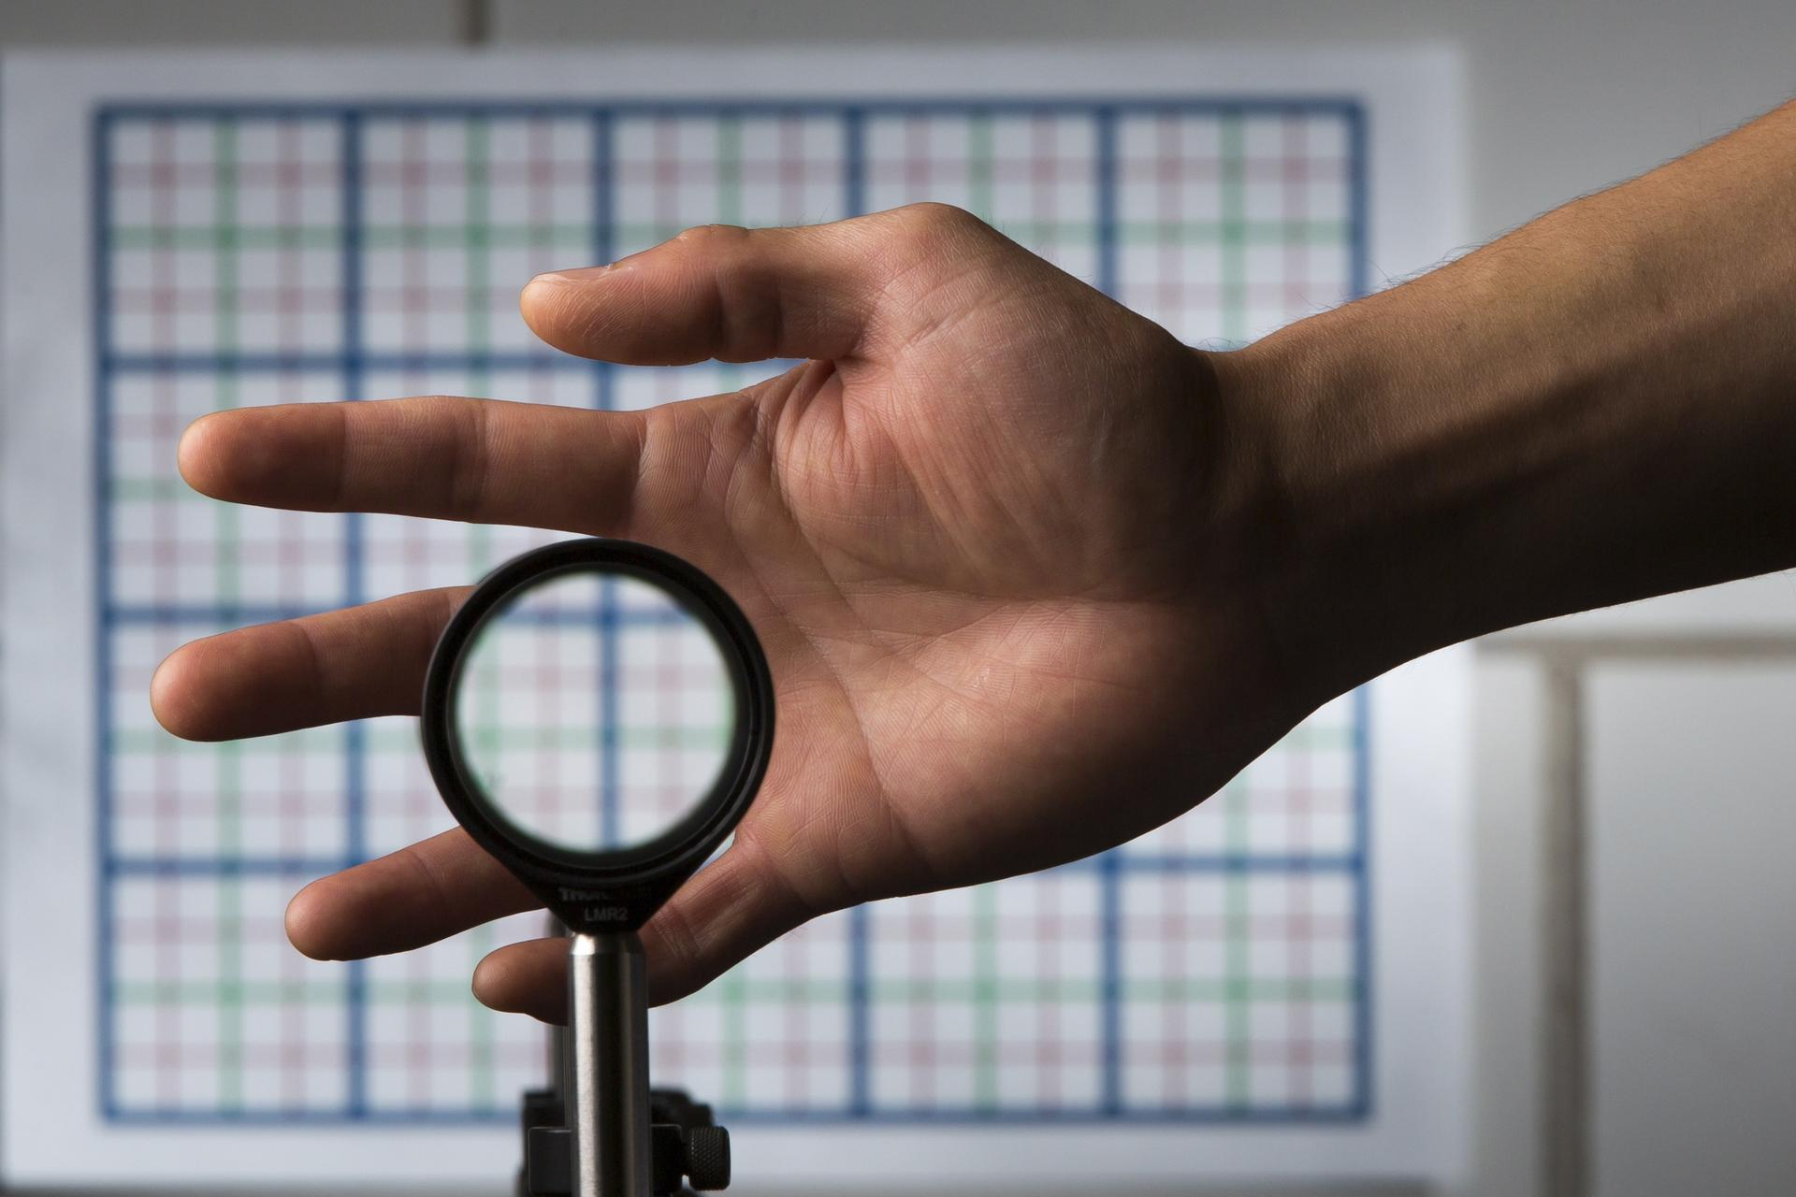
Implementation
Cloaking devices allow for objects to be obscured from at least one electromagnetic spectrum. This is done by the lenses/refractive materials/membranes refracting the light so that it does not go on to the object being cloaked.
Notes:
The cloaking device is made from a group of concentric circles with a cylinder in the middle, where an object can be placed. When researchers direct microwave light at the device, the wave splits, flowing around the device and rejoining on the other side. This is was makes the cloak “invisible”.
Metamaterials makes this possible. Researchers make mosaic-like constructions out of fiberglass sheets stamped with loops of wire. It is similar to a circuit board. It is key to take advantage of the “index of refraction”. This process determines how much light bends when passing through the cloak. To achieve this, is to achieve an invisible cloak.

Slide 6
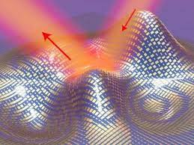
Implementation
How It Works:
-Refractive materials make light go around the cloaked region. It works best when light is scattered, such as in fog or murky water.
-Panels that can change colours and luminosity to blend in to their surrounding.
-Plasma in certain densities is able to absorb some types of broadband waves.
-A thin screen comprised of polycarbonate film and copper strips can cloak an object from microwaves.
-Four spaced lenses allow you to see what is farthest away from the lenses, but not what is in between.
-Objects can also be cloaked from acoustics or mechanics using similar technology applicable.
Types of Cloaking:
-Metamaterial
-Active Camouflage
-Plasma Stealth
-Metascreen
-Rochester
-Mechanical
Notes:
There are many different types of cloaking. These different types include metamaterial, active camouflaging, plasma stealth, metascreen, rochester, and mechanical. How it works is much more complicated:
-Refractive materials that makes light go around the cloaked region. It works best when light is scattered, such as in fog or murky water.
-Panels that can change colours and luminosity to blend in to their surrounding.
-Plasma, which is held within thin membranes, in certain densities is able to absorb some types of broadband waves.
-A thin screen comprised of polycarbonate film and copper strips that can cloak an object from microwaves.
-Four spaced lenses that allow you to see what is farthest away from the lenses, but not what is in between.
-Objects can also be cloaked from acoustics or mechanics using similar technology applicable to that field.

Slide 7
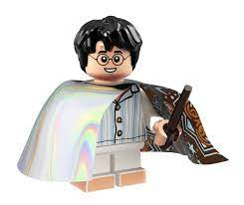
Positives
-Can help medical professionals.
-Can be utilized by the military.
-Could benefit people in positions of power/high profile individuals (world leaders).
-Hides people in times of danger.
Notes:
Medical professionals can see past things in the way (such as their hands/surgery tools or other body parts) to see the things they need to operate on.
The military can use this to hide military equipment and weapons in battles against other powers.
People in positions of power could use cloaking devices to hide them as they can be very valuable in times of danger.
In general, the cloaking device can hide anyone when they are in danger, although this is double sided as dangerous people could use these invisibilty cloaks to watch others, and commit crimes without detection.

Slide 8

Negatives
-Can be used in negative ways.
-An improvement in wartime technology that could be used against civilians.
-Could be mass produced could cause societal problems.
-Surveillance would most likely increase due to the new freedom people would have (if devised right, this could make security cameras obsolete).
-A lag between the creation of cloaking devices and the development of societal norms/ways to deal with even minor issues present with people being able to be invisible.
Notes:
Negative ways: there will always be bad people, and now there could be bad people with unseen items, which would make the world more dangerous.
Other wartime tech improvements have always had negative results, for while it works better for the side using it, it allows that side to be more effective in war, which leads to more deaths. It can also be used to ambush/attack settlements, such as an improved Blitz.
The fact that potentially anybody could become invisible at will would have almost infinite ramifications. As of right now, we do not have the technology to detect where things we can't see are, and the fact that anybody could be running around without being seen would give them freedom to do many things.
Less privacy, more of a surveillance state. People with ill intentions could still use this technology to their advantage, while other citizens would suffer from an extreme lack of privacy.

Slide 9
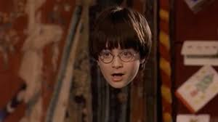
Opinions
Although the cloaking device is not fully developed and has a long road ahead of improvements, the cloaking device is a technology that is astounding.
The majority of people only know the cloaking device from stories of fiction, so for this to be a reality is incomprehensible.
We believe that this technology is very cool and would be extremely intrigued to see this as a real product used in the future.
However, with an invention so amazing, there is certainly an aspect of caution as the use of this device could be used and manipulated very easily.
Notes:
Although the cloaking device is not fully developed and has a long road ahead of improvements, the cloaking device is a technology that is astounding to to think that it could be a reality. The majority of people only know the cloaking device from stories of fiction, so for it to be a reality is not yet comprehendible. We believe that this technology is very cool and would be intrigued to see this as a real product used in the future. However, with an invention so amazing, there is certainly an aspect of caution as the use of this device could be used and manipulated very easily. We do not believe that this product should be mass produced to the public as it is inevitable that people will abuse it.

Slide 10
References
https://www.memphisdailynews.com/news/2015/feb/28/quick-history-of-cloaking-devices/
https://military-history.fandom.com/wiki/Active_camouflage
https://newatlas.com/ultrathin-invisibility-cloak-uc-berkeley/39477/
https://www.nbcnews.com/science/weird-science/scientists-show-you-how-make-invisibility-cloak-sort-n210961
https://www.rochester.edu/newscenter/watch-rochester-cloak-uses-ordinary-lenses-to-hide-objects-across-continuous-range-of-angles-70592/

